Slide 1
Andromeda
By: Jason Yang

Slide 2
Organization
The website application is designed for everyone of all ages but mostly adults ranging from 18 years old and beyond.
Kids can use the application, but they would need an opened bank account to pay for items or rent items.
People who want to rent items instead of buy items.

Slide 3
Goals
The main goal of this project is to start from a concept into a real and interactive internet application.
To provide items to those who prefer to pay little to rent an item or only need an item for a certain amount of time.
To help those people with saving money and provide a better alternative option compared to Amazon, eBay, and other e-commerce.

Slide 4
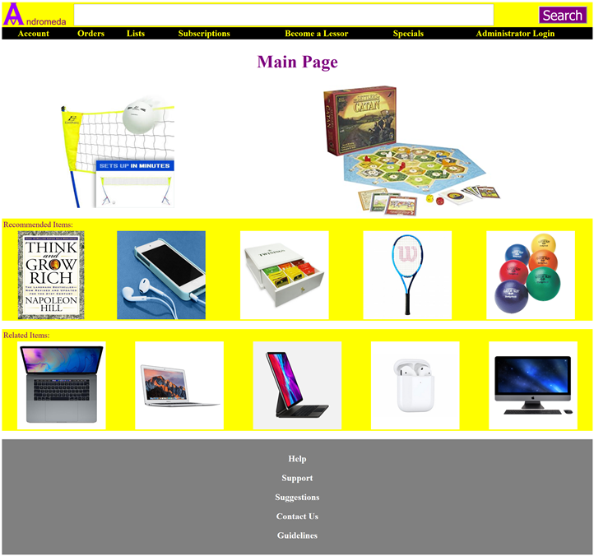
Main Page
Andromeda: an e-commerce website for buying, selling, renting, and leasing.
People must create account to buy, sell, rent, or lease items.
Users can subscribe to gain more benefits.
Users must understand guidelines before using services.
Users must understand leasing policy before leasing items.
Notes:
This is my main page. It shows a lot of pictures of items such as sport equipment, electronics, book, and board game. So, this website that I am creating for this project is an e-commerce website. Not only users can buy or sell items, they can also rent or lease items. The renting process goes like this: First, You check the guidelines for renting items and create an account for the website. When you understand the guidelines for renting an item, you can then rent items. Renting items is like buying items, but in this case, you add item to your order and click as rent. The item will be shipped, and, in another page, you will see the approximate date for it to be delivered. You can also see when you must return the item back to the lessor. You can then stop by the delivery services such as USPS or UPS or FedEx to ship the item back to the lessor. If you don’t return the item on the returned date, you will get penalized by paying a little bit more; however, you have two options: One, you can return the item asap or two, you can submit that you want to keep the item and pay for the asking buying price for the item and do not have to pay for not returning the item. One final notice is that you can subscribe to the website, but more information will be mentioned in later slides.

Slide 5

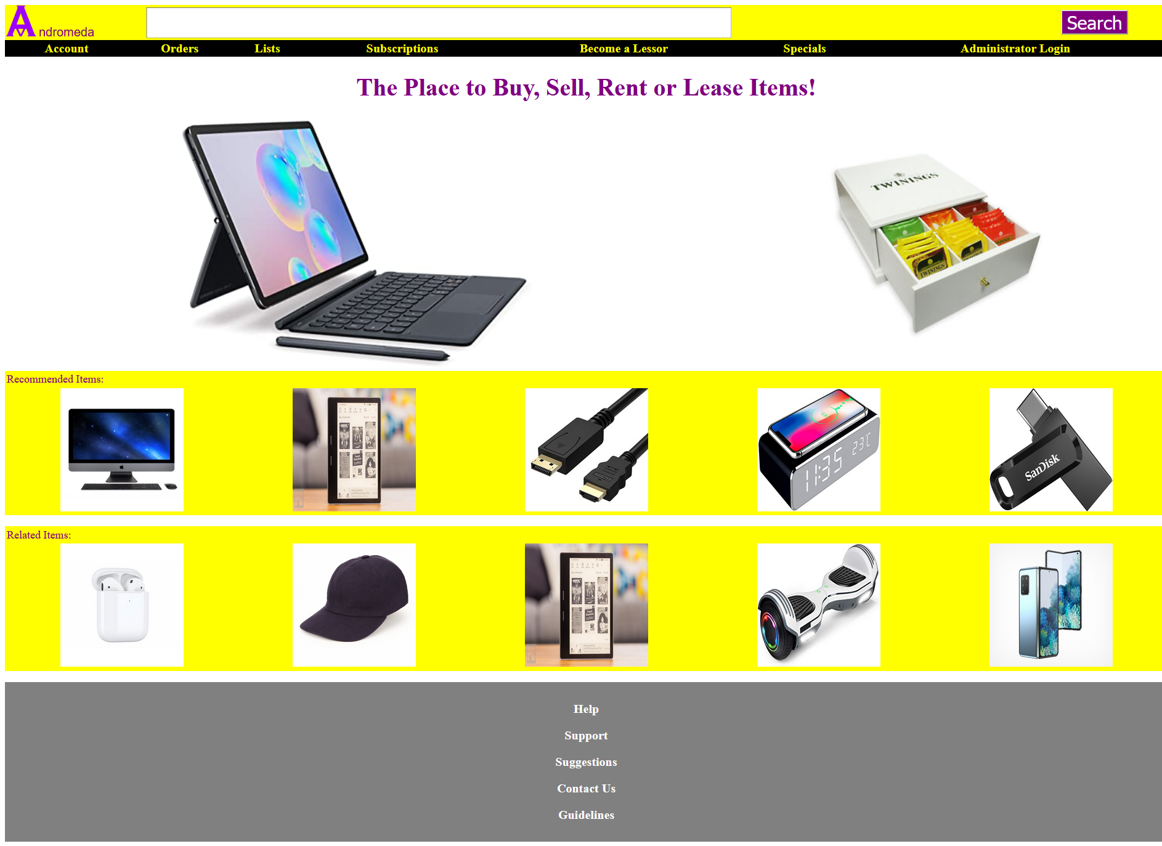
Main Page Changes per visit
Notes:
So far, the main page can display many pictures from the database. It also changes each time you visit the main page.

Slide 6
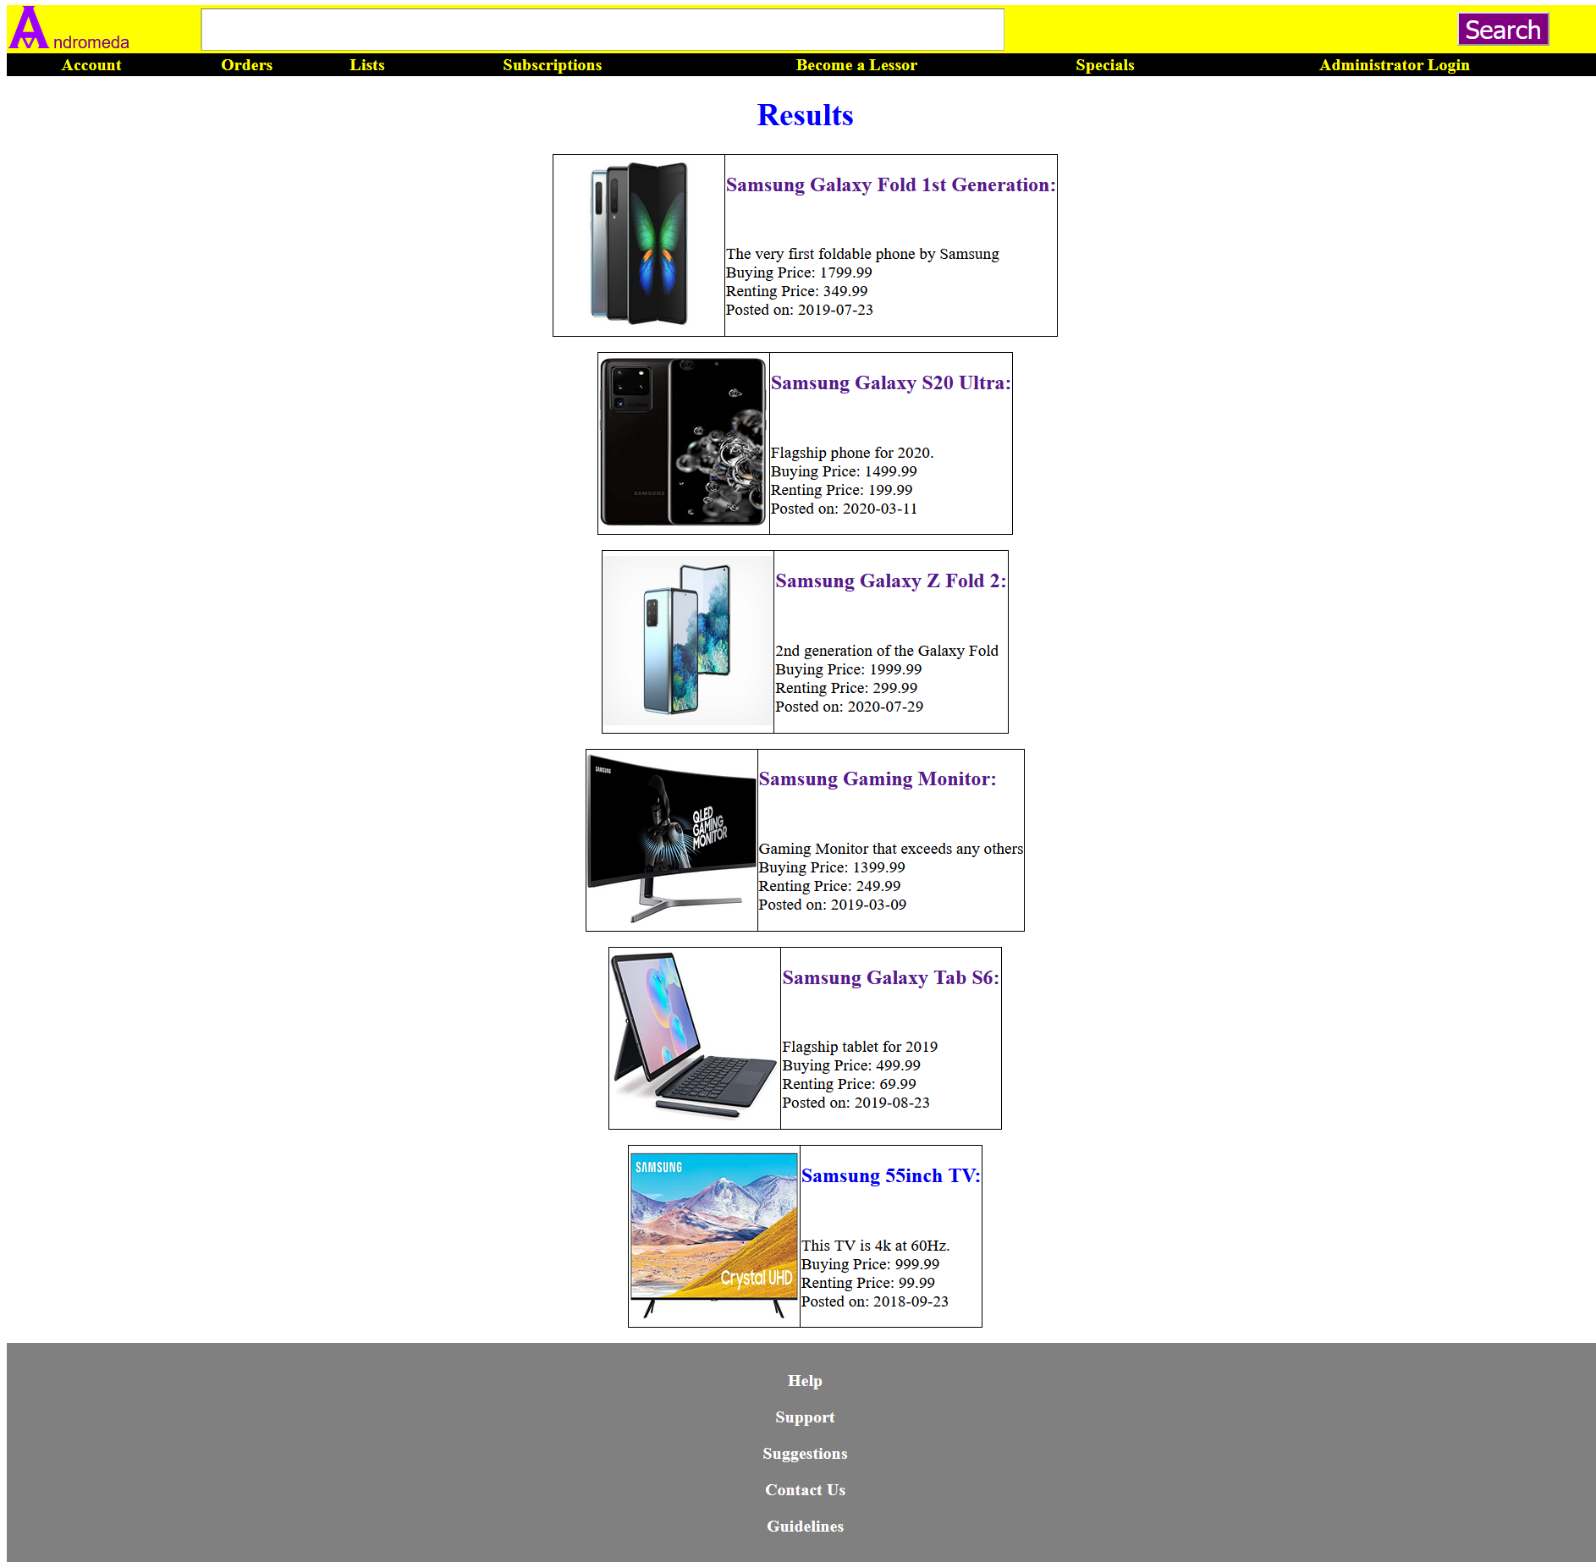
Searched Result Page
Retrieved items with name that matches the input from the search bar.
Samsung is the searched term.
Notes:
This is the result page. To access this page, users must press the purple search button on the top right corner of the page. I’ve also use php, so the yellow bar that have the Andromeda logo, search field, and purple search button along with the black bar with the gray bar to appear in all pages on the website. For this case, I’ve inputted “Samsung” into the search field and press the purple search button on the top right corner of the page. This is the result. Php can look into the mysql database and look for items’ title that have the same string as the searched term. As you can see, I have some items that have Samsung in their title in the mysql database. The website also shows not only the title but also the description, buying price, renting price, and the date that the item was posted (the date is manually inputted in the mysql database, so it is not the present time that it has been registered). Users can click on the title or picture to see the item in more detail in items page.

Slide 7
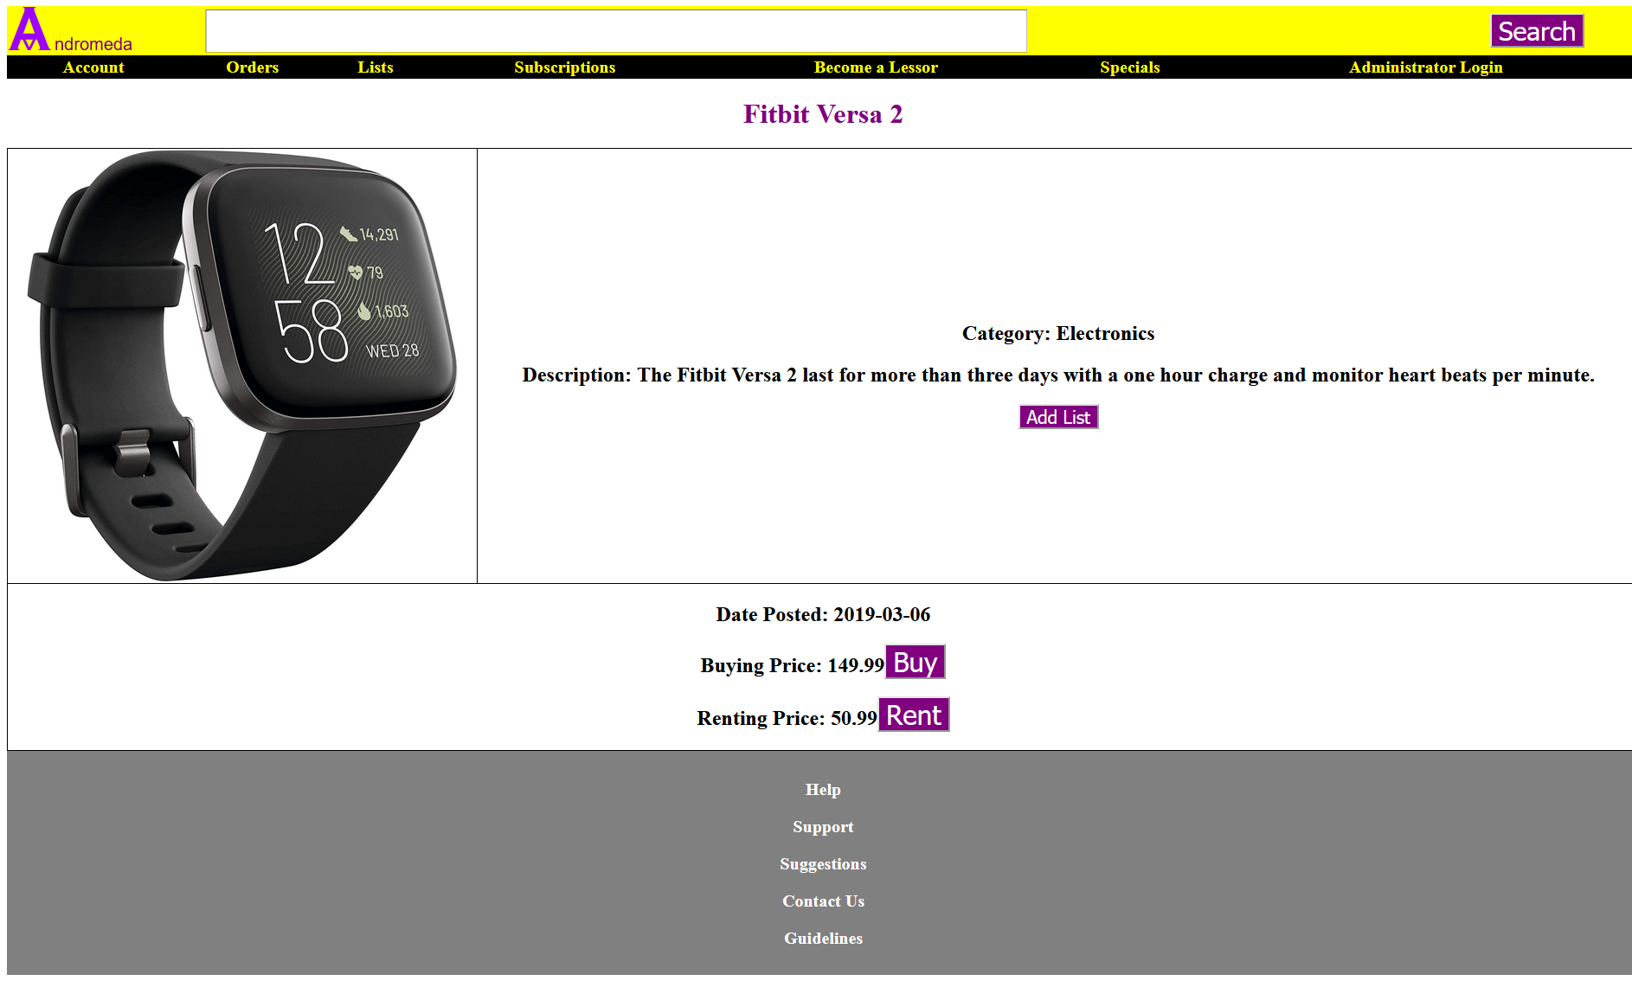
Each Item has their own Page
Notes:
Each item have their own page where visitors can see the name, category, description, date posted, buying price, and renting price. They can put the item in a list, buy the item and add it to the orders page or rent it to the orders page.

Slide 8
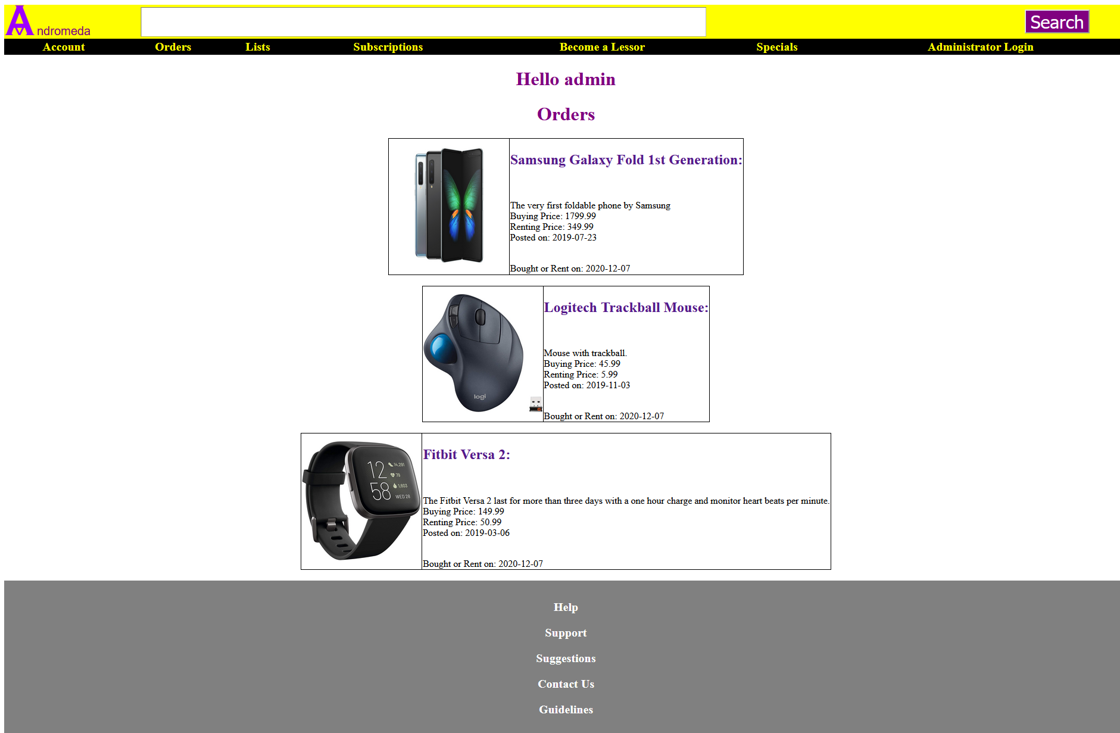
Orders Page
Notes:
When clicking on the buy button or rent button, the items are added to this page and displayed. This is a retrieval function in mysql and php. Users can also see when they added the item in the orders page.

Slide 9
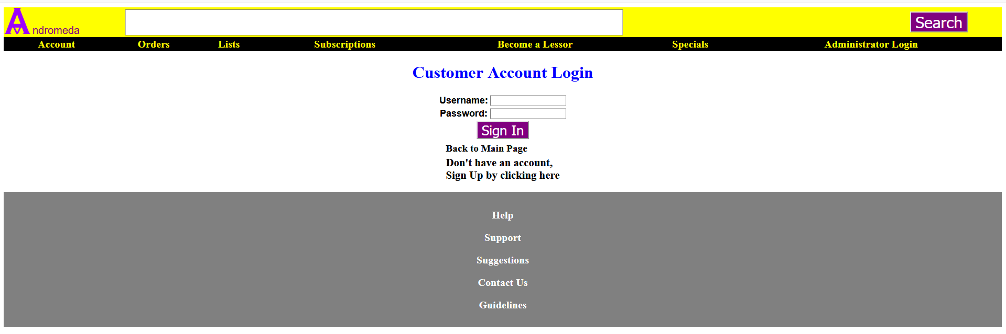
Sign In Page
Notes:
This is the Customer Account login page where any customer who have registered to the website can access to personalized account details, orders, lists, subscriptions, leased items, special deals, and more. The customer table from my mysql database will read the email and password for the session to begin when users have successfully logged in. Also, users can press the “Back to Main Page” text to go back to the main page. Pressing the logo or the “Andromeda” text on the left top corner will direct the user to the main page as well. If a person do not have an account, they can click on the “Don’t have an account, Sign Up by clicking here” text to be directed to the Sign Up page.

Slide 10
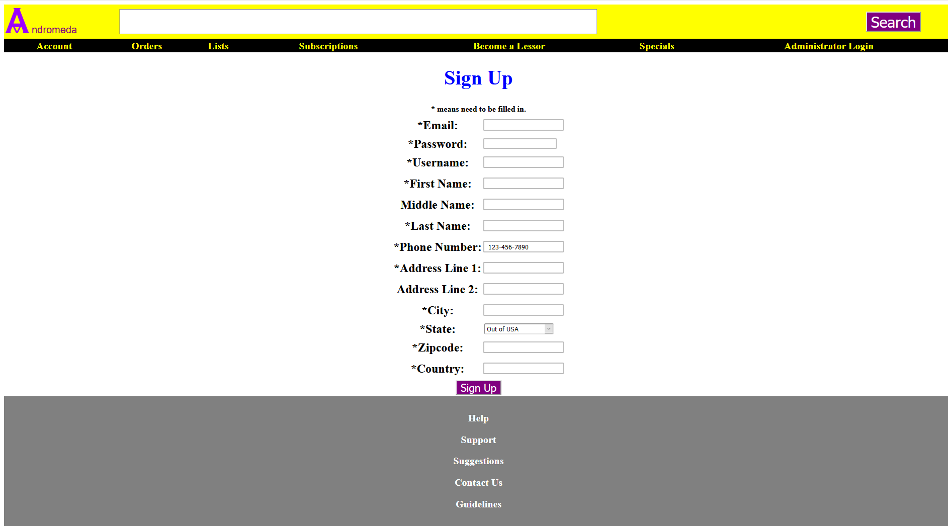
Insertion MYSQL Function: Sign-Up Page
Notes:
This is the Sign-Up page, people who want to use the service of this website will need to register. The text that have an asterisk is required to complete the registering process. They do not have to input for Middle Name or Address Line 2. They can also click on Out of USA for state if they do not live in USA. They can click on the drop-down menu to be able to click on their state that they live in if they live in the US.

Slide 11
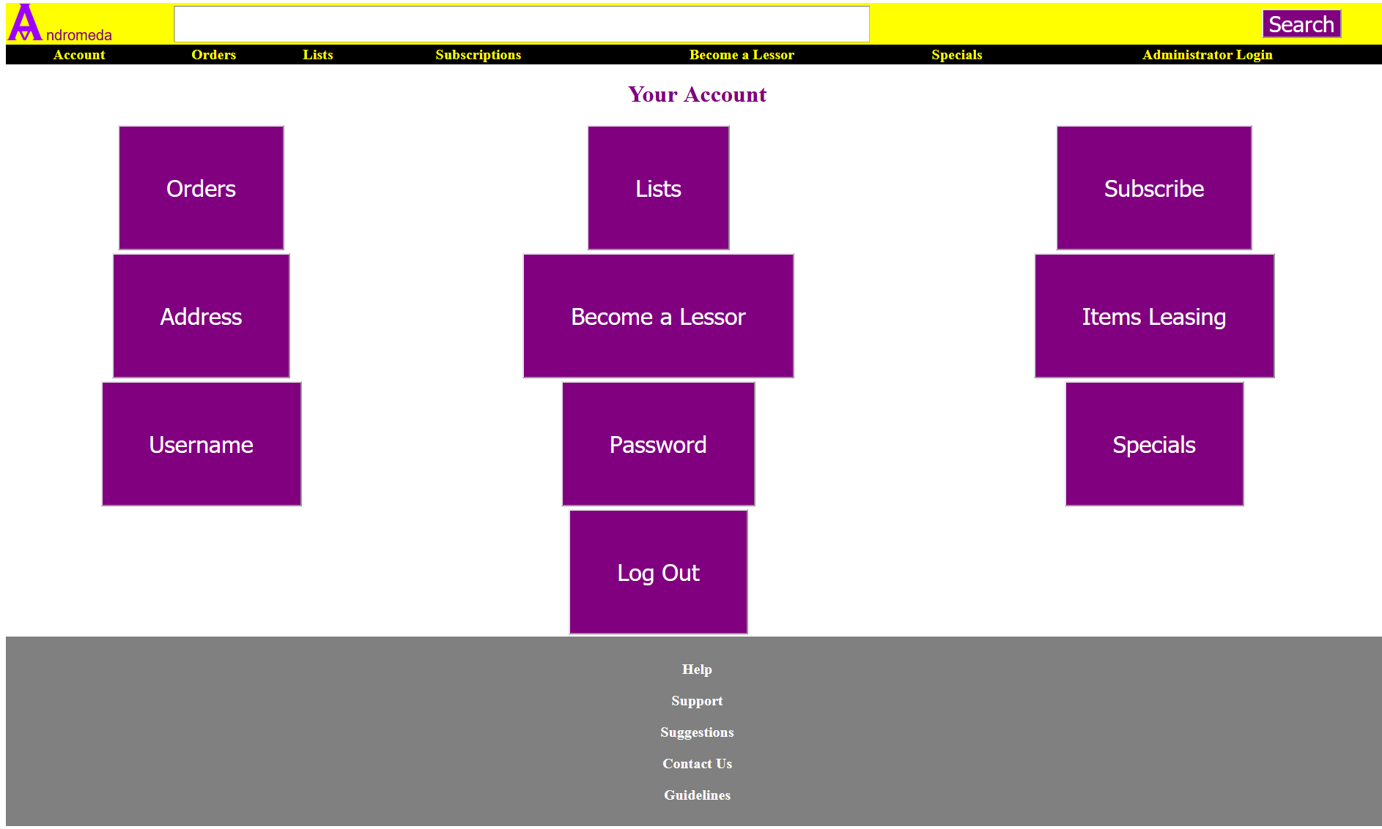
Account Page
Notes:
The account page is shown for an account that has been created.

Slide 12
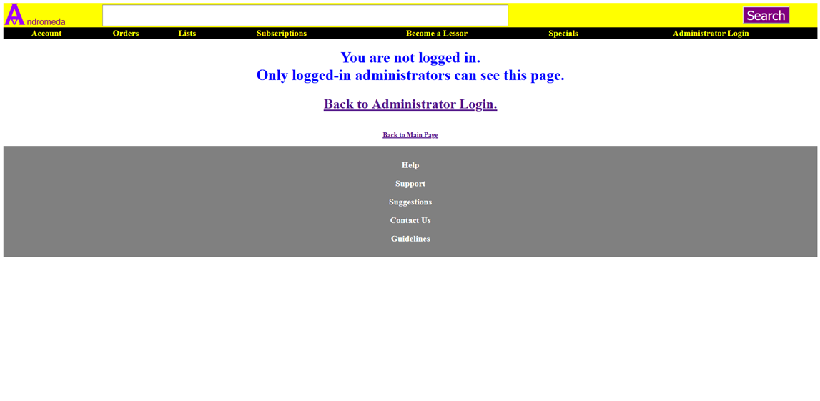
Most links can only be access through logging in.
Notes:
Most of the pages do not allow users to see until they have successfully log in. I was able to implement the session so when users successfully signed in, they will start the session and be able to access most of the pages on the website.

Slide 13
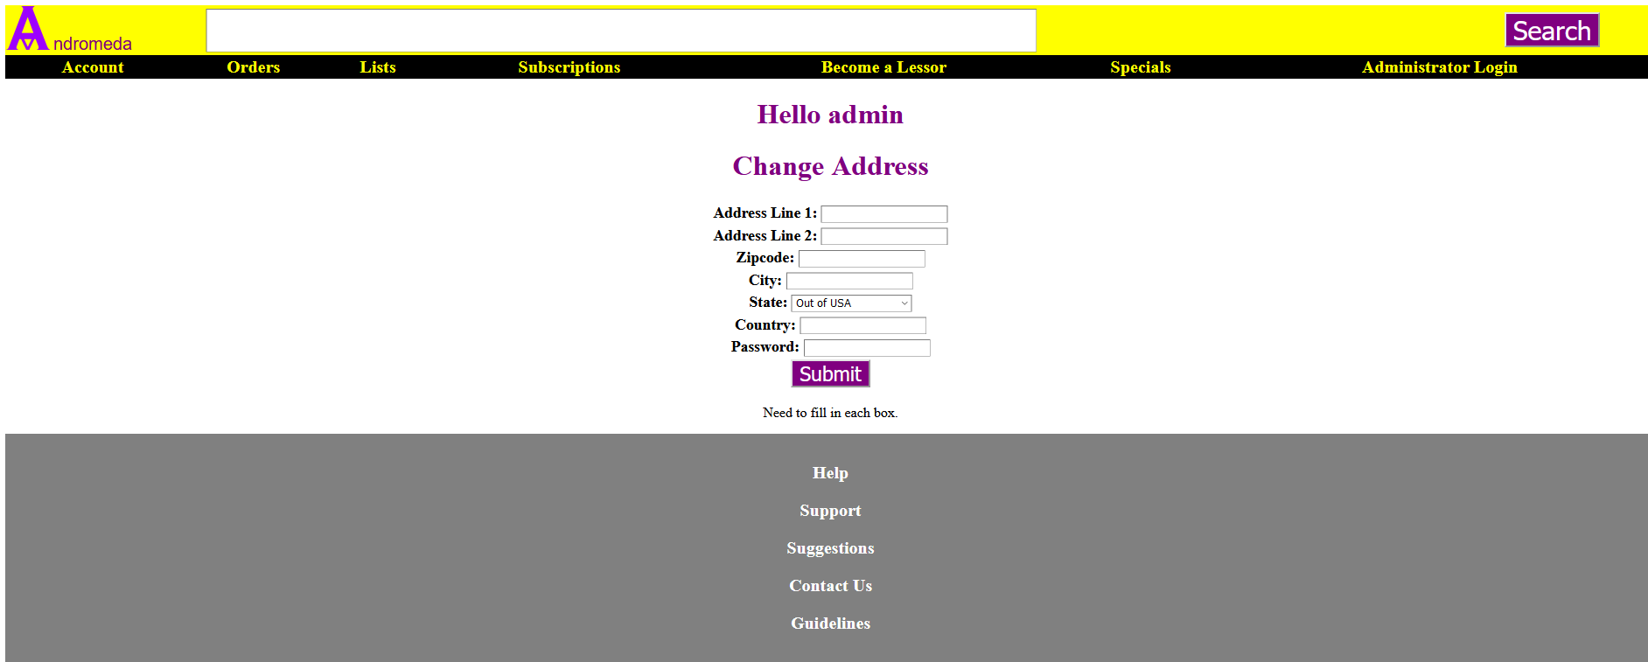
One Update MYSQL Function: Address
Notes:
The user can update their address and the website knows who will be changing their address, so in this case, there is no need for username to be input here. The password is here to make it more difficult for people who do not know the password to change the address.

Slide 14
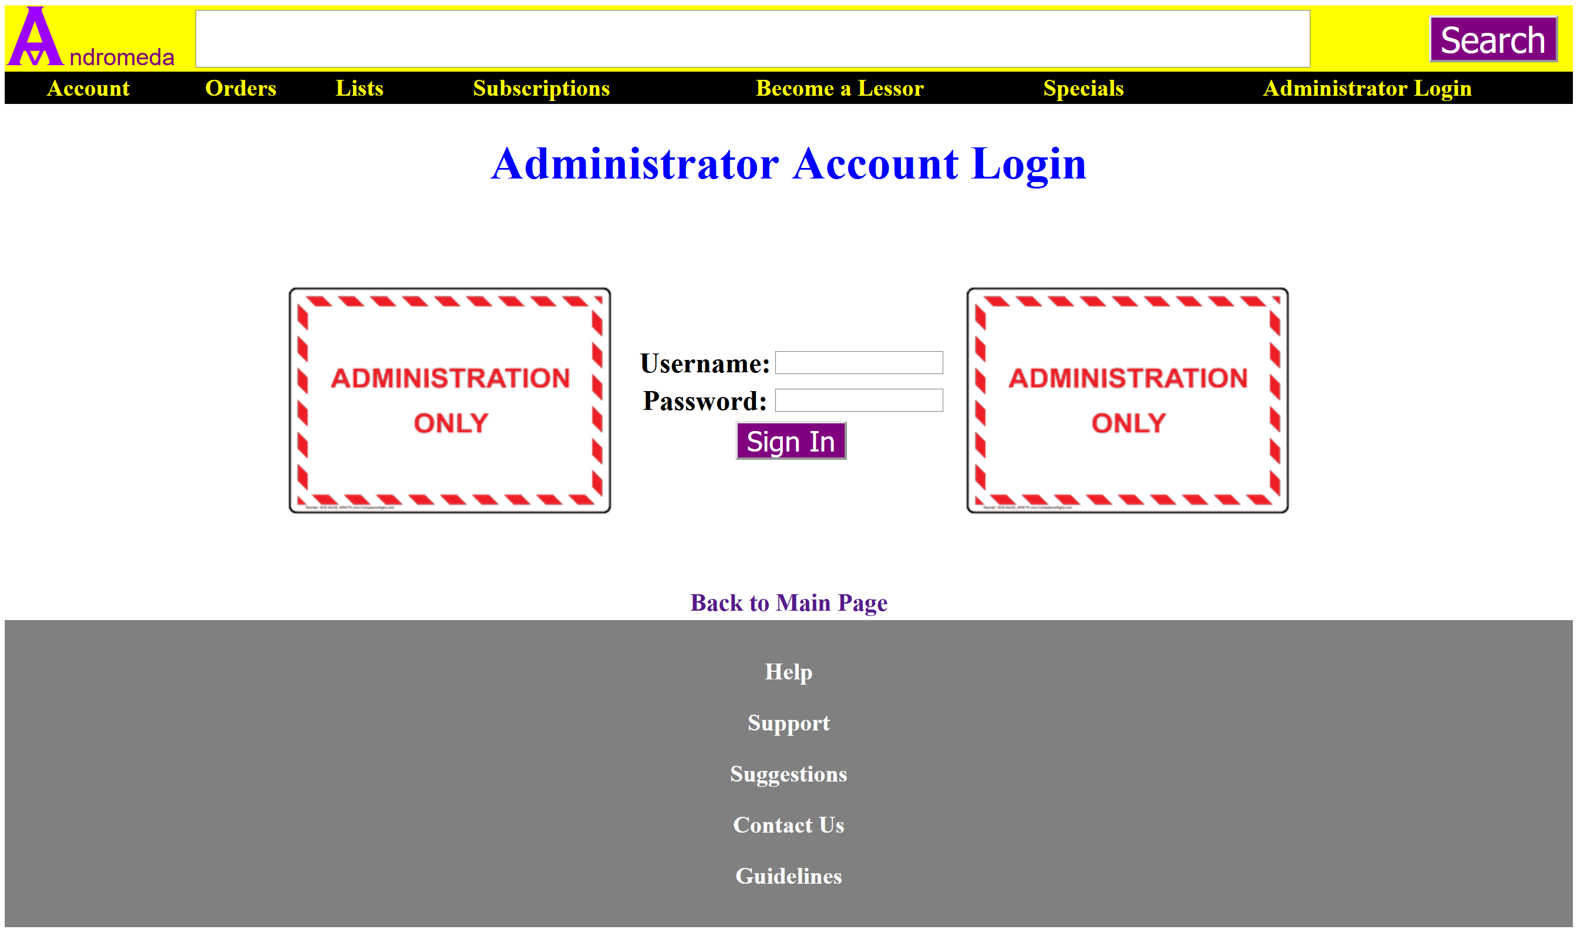
Administrator Login Page
Notes:
This is one of the most important page for website. This is where the administrator will login. I am going to use mysql and php for the admin account with the correct type, username, and password to successfully log in.

Slide 15
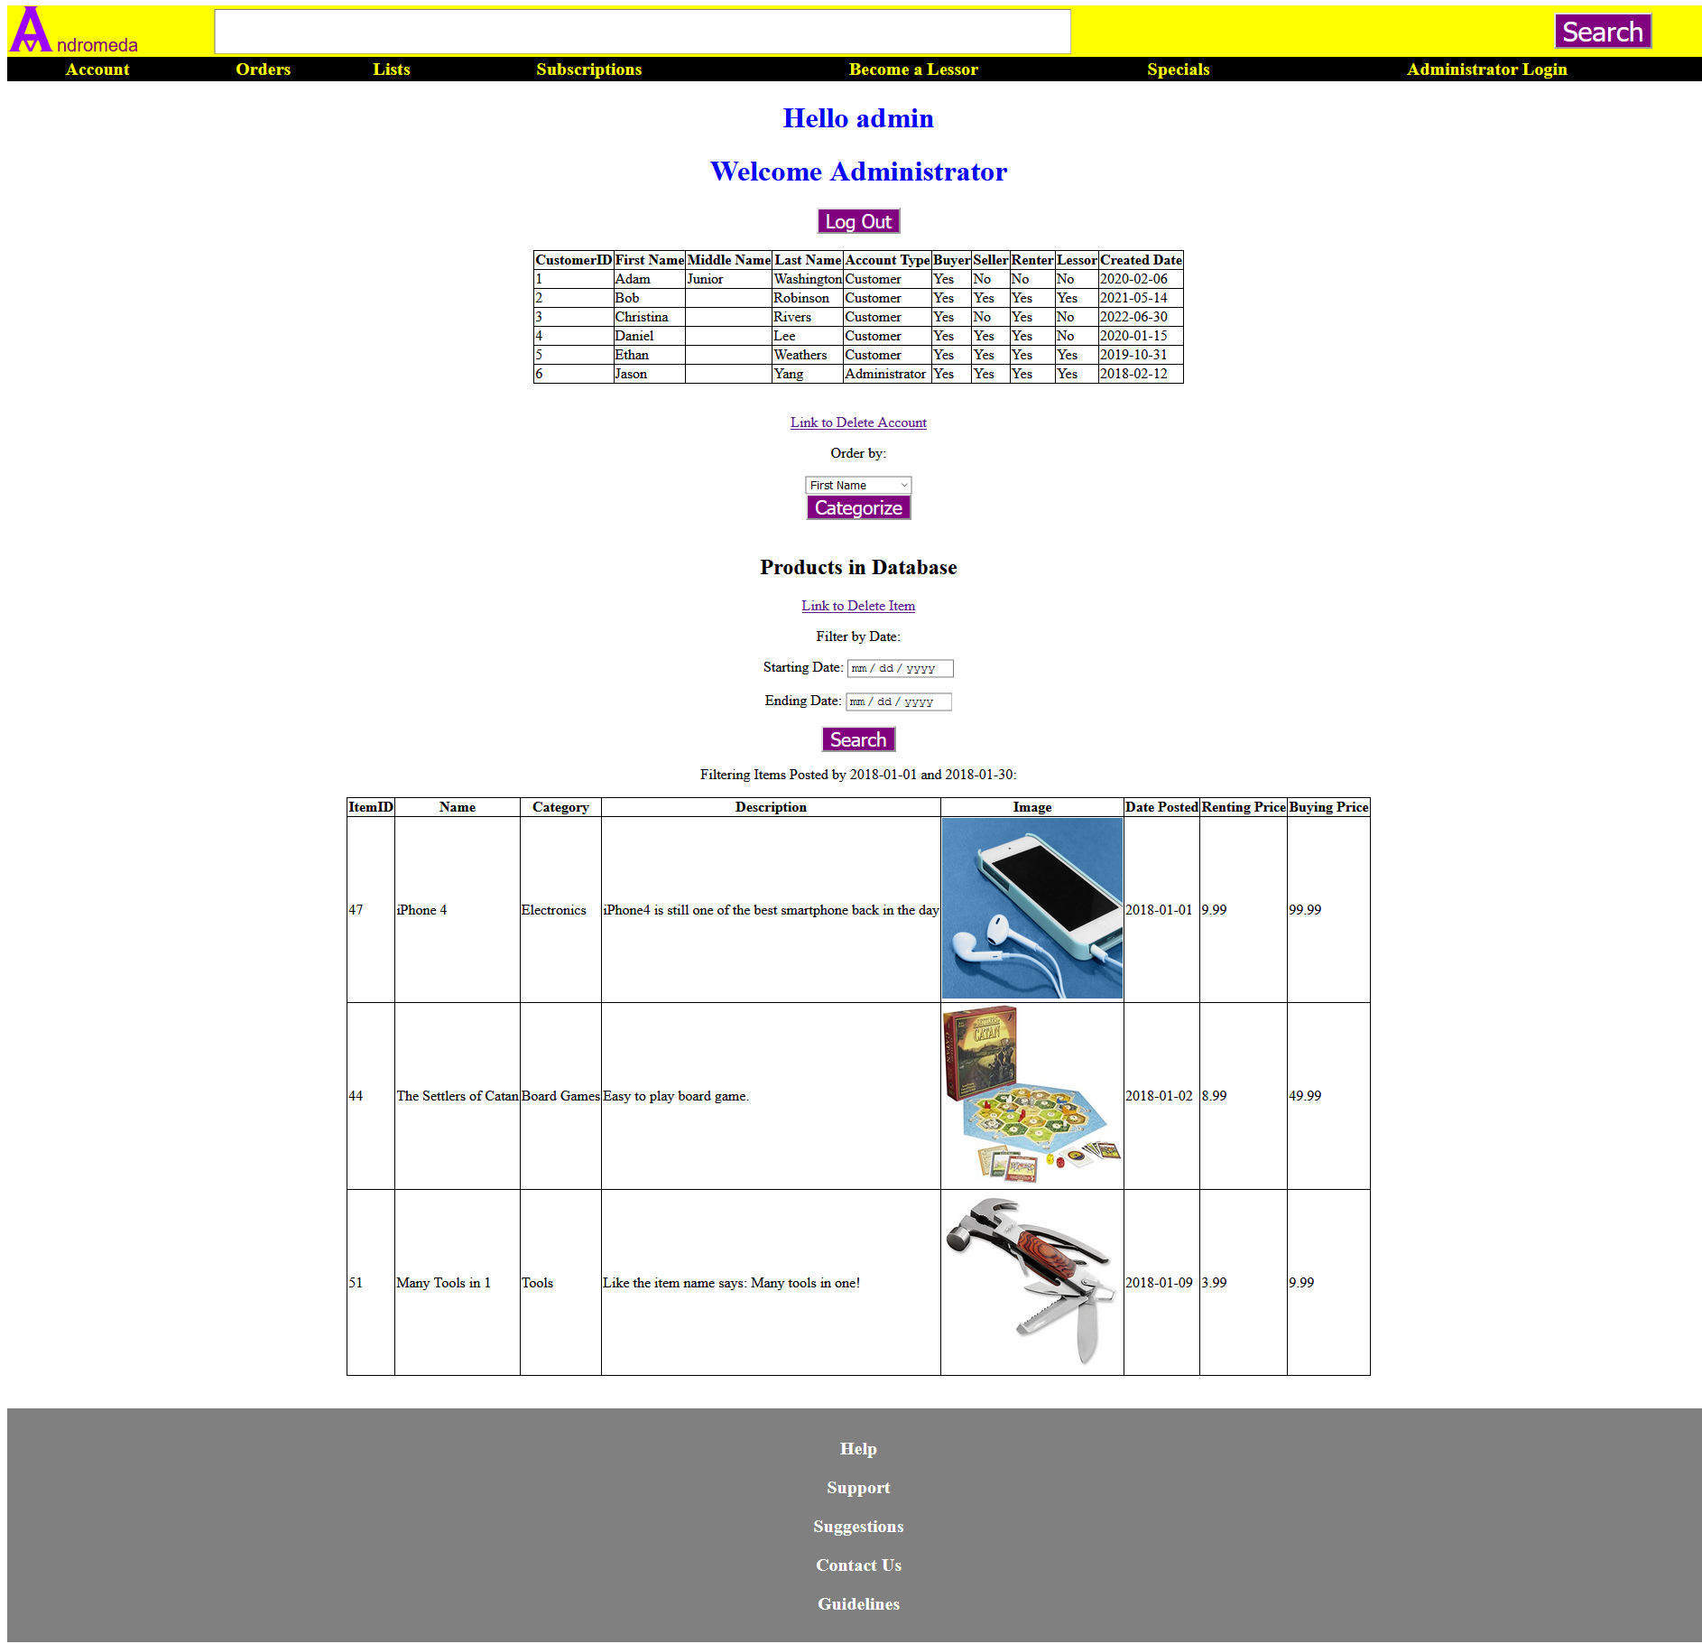
Administrator Page
All customer account are displayed along with all items order by date by default.
Account can be order from first name to created date.
Items displayed here are from January 1, 2018 to January 30, 2018.
Notes:
This is the administrator page where the administrator can see all the created account for the website and all items registered by user in the database. The admin can categorize all accounts by first name, middle name, last name, account type, seller type, buyer type, renter type, lessor type, or created date. I also include the option to delete account or item. The admin can also filter all items in the database by starting date to ending date which in this case is from January 1, 2018 to January 30, 2018. There is a text welcoming the admin. Also, there is a logout button for the admin to log out.

Slide 16
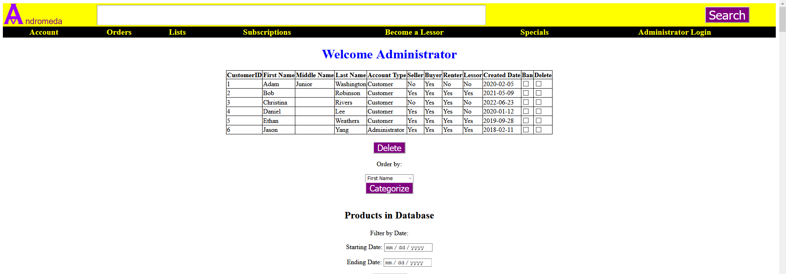
Administrator Page
Before selecting Registered date.
Notes:
This is the result before selecting registered date. As you can see on the created date column, the dates are randomly ordered.

Slide 17

Administrator Page
After selecting Registered Date on drop down list and on Categorize button
Customer account are ordered by created date.
Notes:
This is the result after clicking the drop-down list, selecting registered date, and clicking on the Categorize button. The date values in the Created Date column are in order by ascending order.

Slide 18
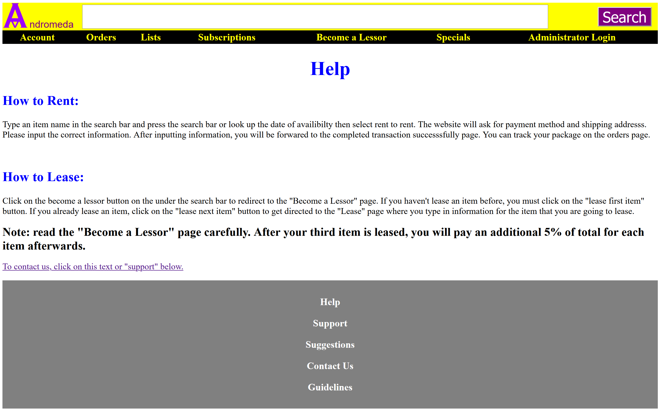
Help Page
Notes:
So, the slide here to the end are the pages shown when the users click on any of the white text on the gray bar on the bottom of the website. This is the help page which is straightforward. This is page is mostly for people who don’t understand how renting and leasing work for the service that Andromeda provides.

Slide 19
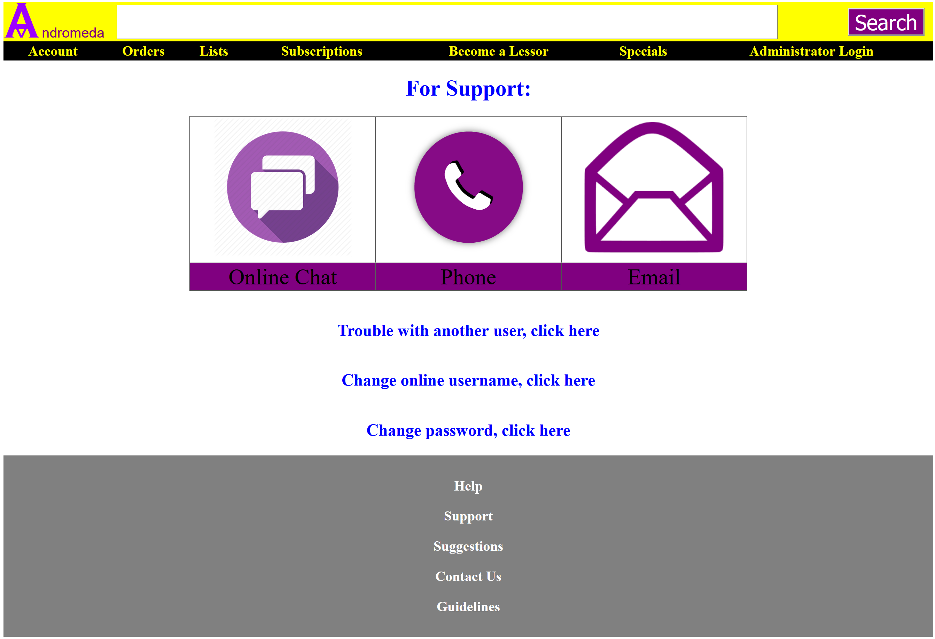
Support Page
Notes:
This is the support page. This page have link to the online chat which is not created yet. The phone and email will refer to the Contact us page. Trouble with another user text will direct users to another page which will be in the next slide. Change online username and password will direct users to the change username page or change password page.

Slide 20
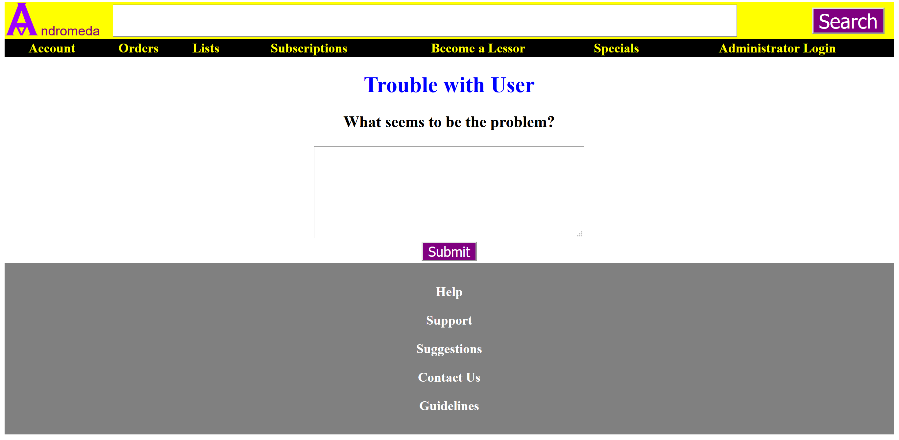
Trouble with User Page
Notes:
I am going to use php and probably mysql for users to send a large text to the admin’s email, but not sure. This is for users who have problems with other users and need a person to settle the result.

Slide 21
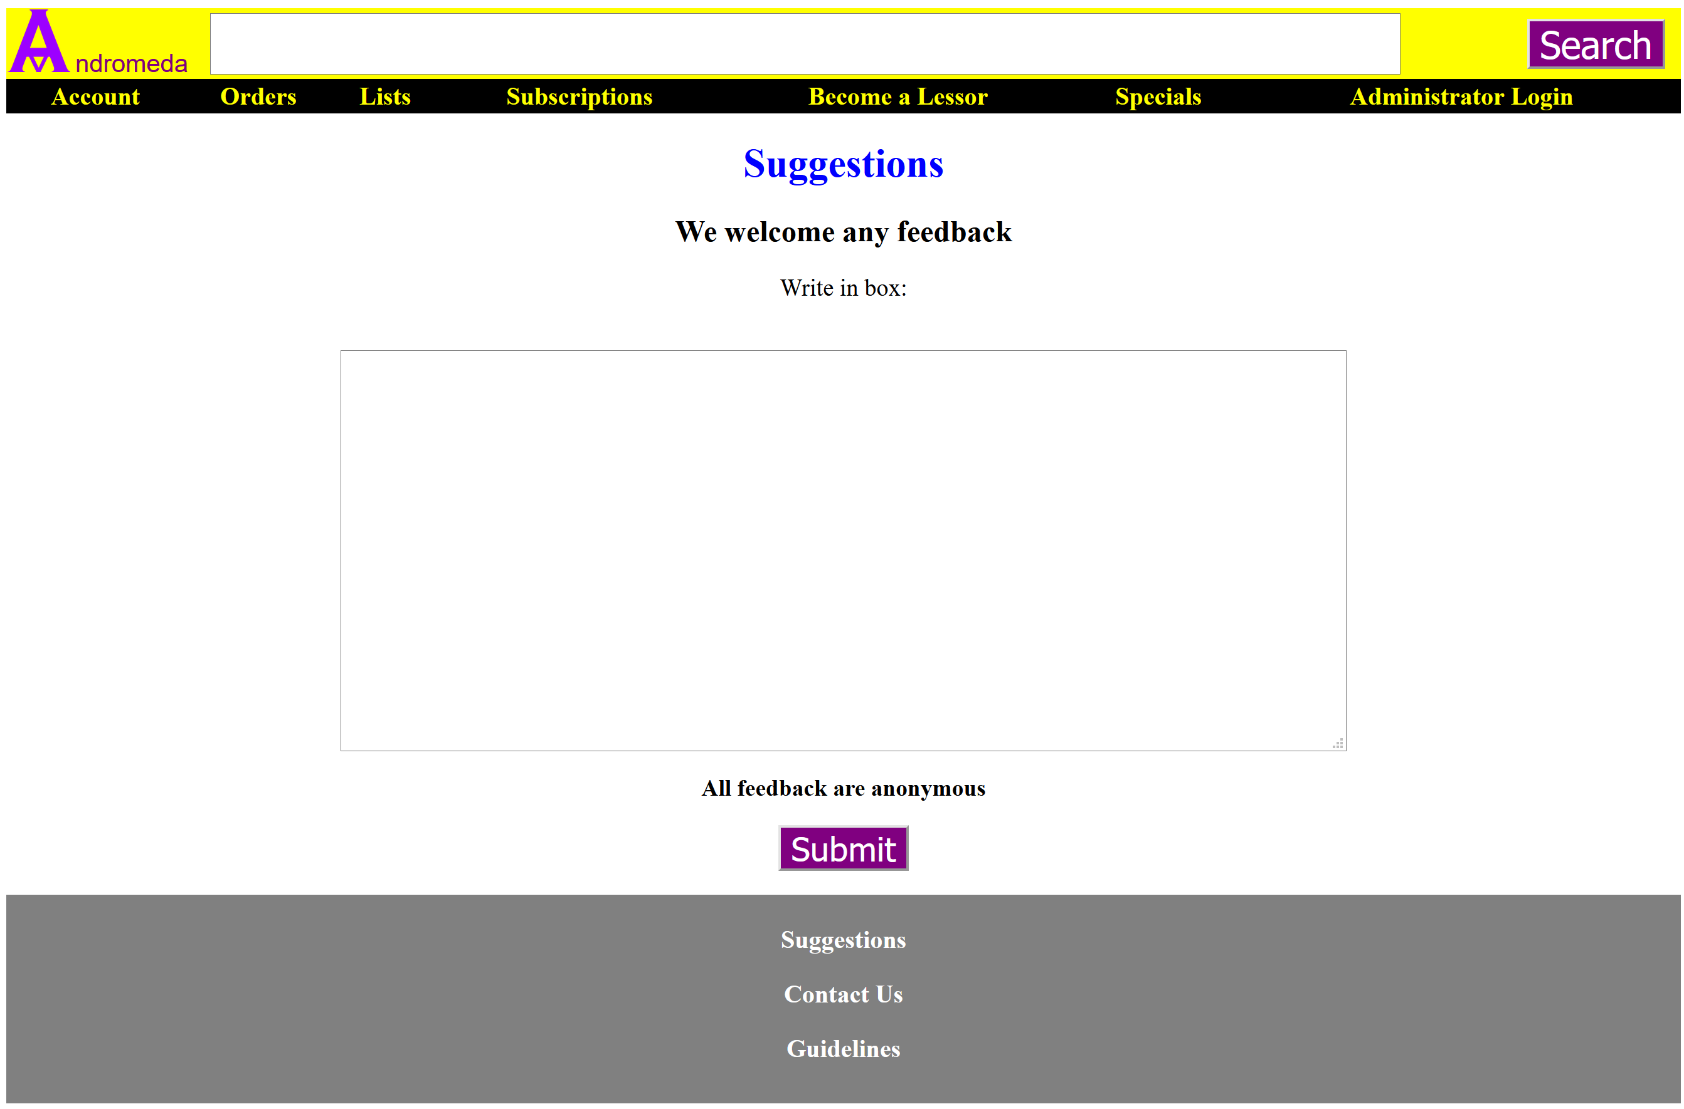
Suggestions Page
Notes:
This is where users can input anything, and the text will be sent to the admin in email. The sender will be anonymous.

Slide 22
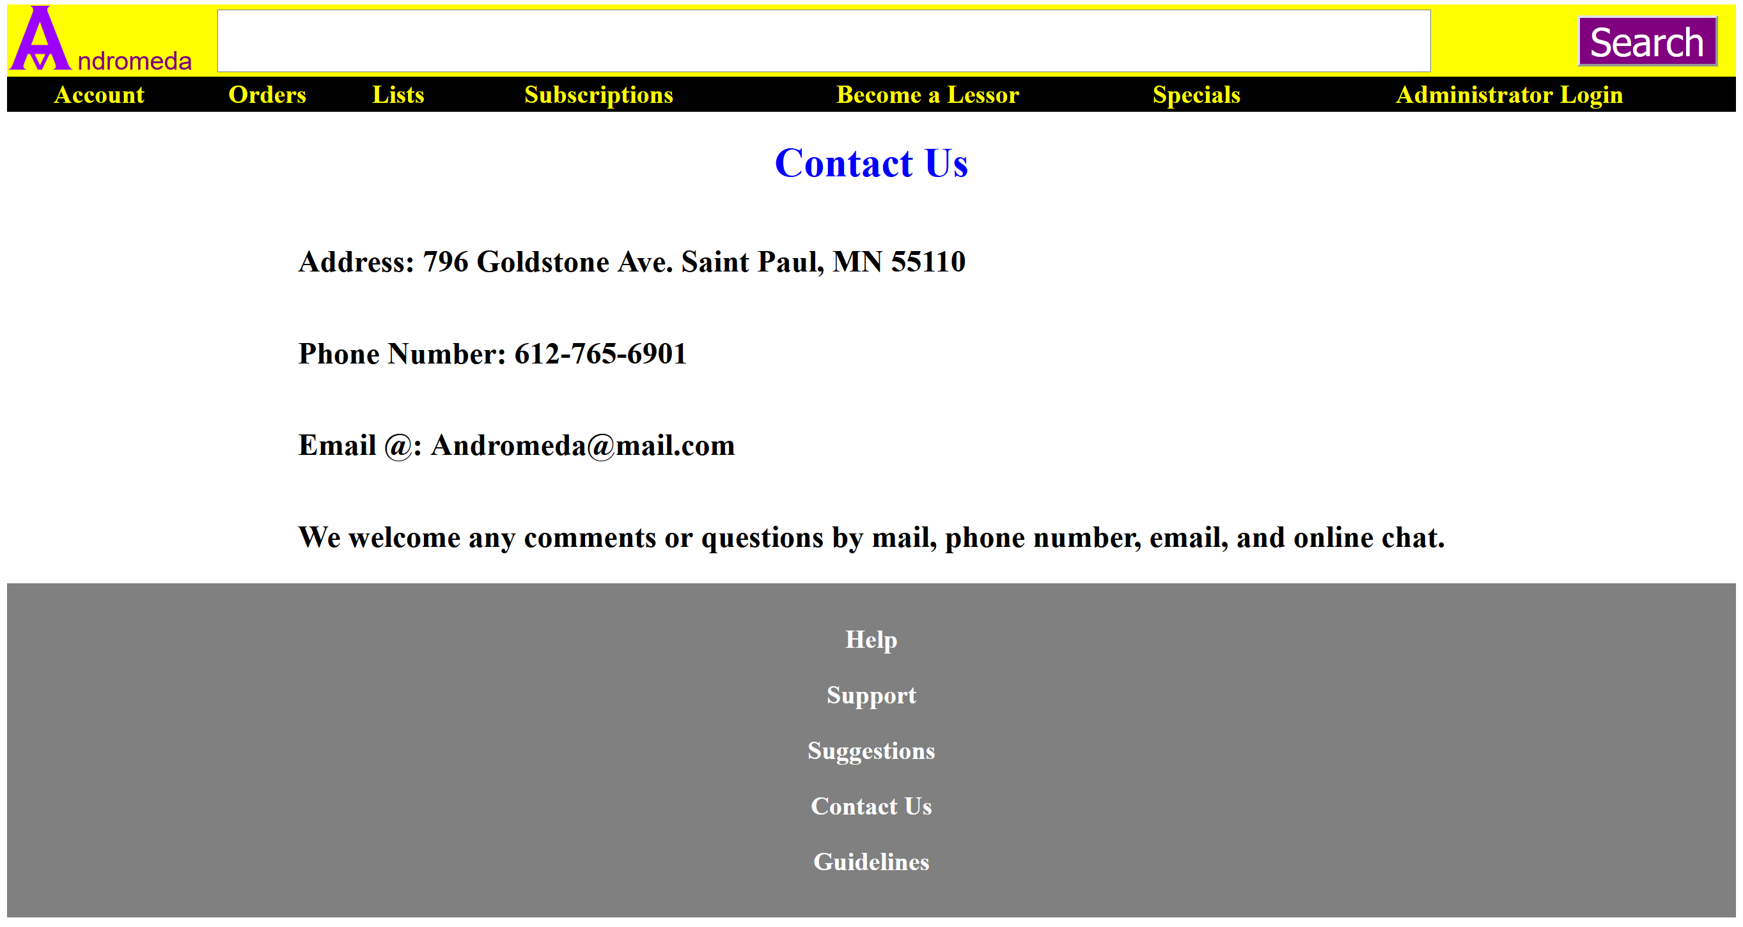
Contact Us Page
Notes:
This is where users can contact the Headquarters of the company. This information is fake for now.

Slide 23
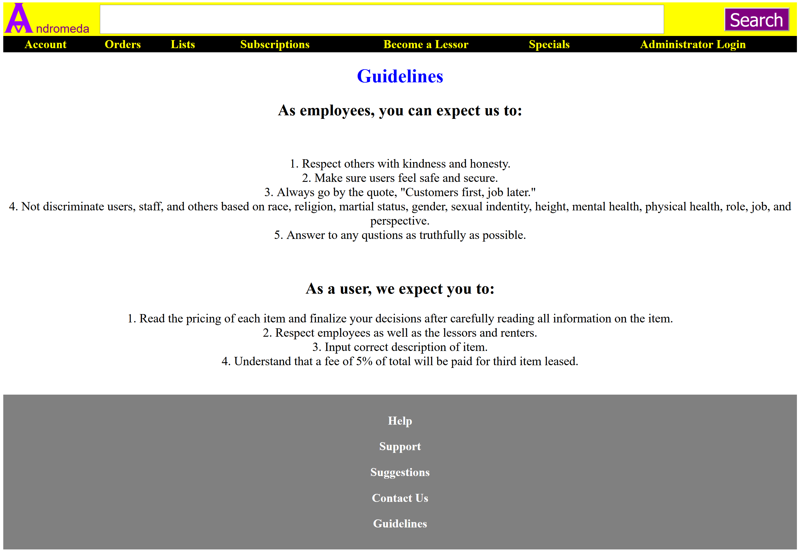
Guidelines Page
Notes:
This pages shows what all users should look at before going to other pages. I think that if users and employees understand this page, there would be less problem for both.

Slide 24
Improvement
Improve the visuals of the website.
Learn to use bootstrap to make the website look better.
Learn to use javascript for interaction to the website.
Learn some Jquery.
Experience teamwork.
Learn to work with others on a project.
Add Review section for each item.
Apply transaction for orders.
Apply delivered date, returned date, and shipping date.
Making images for items look better according to their original size.

Slide 25
Thank You
Notes:
Thank you for listening to my presentation. I hope you all like it.

